Slide 1


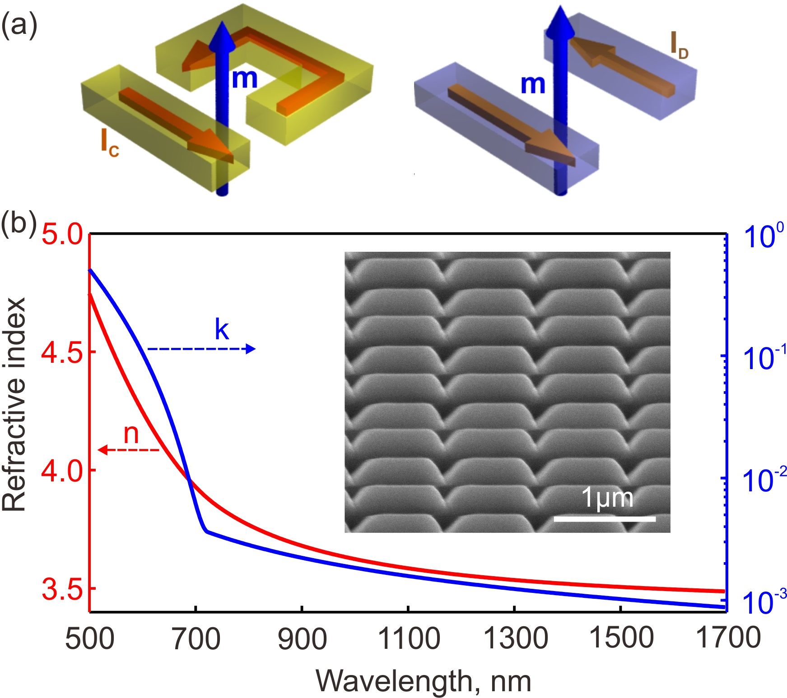
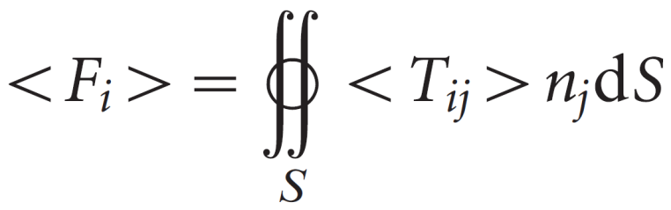
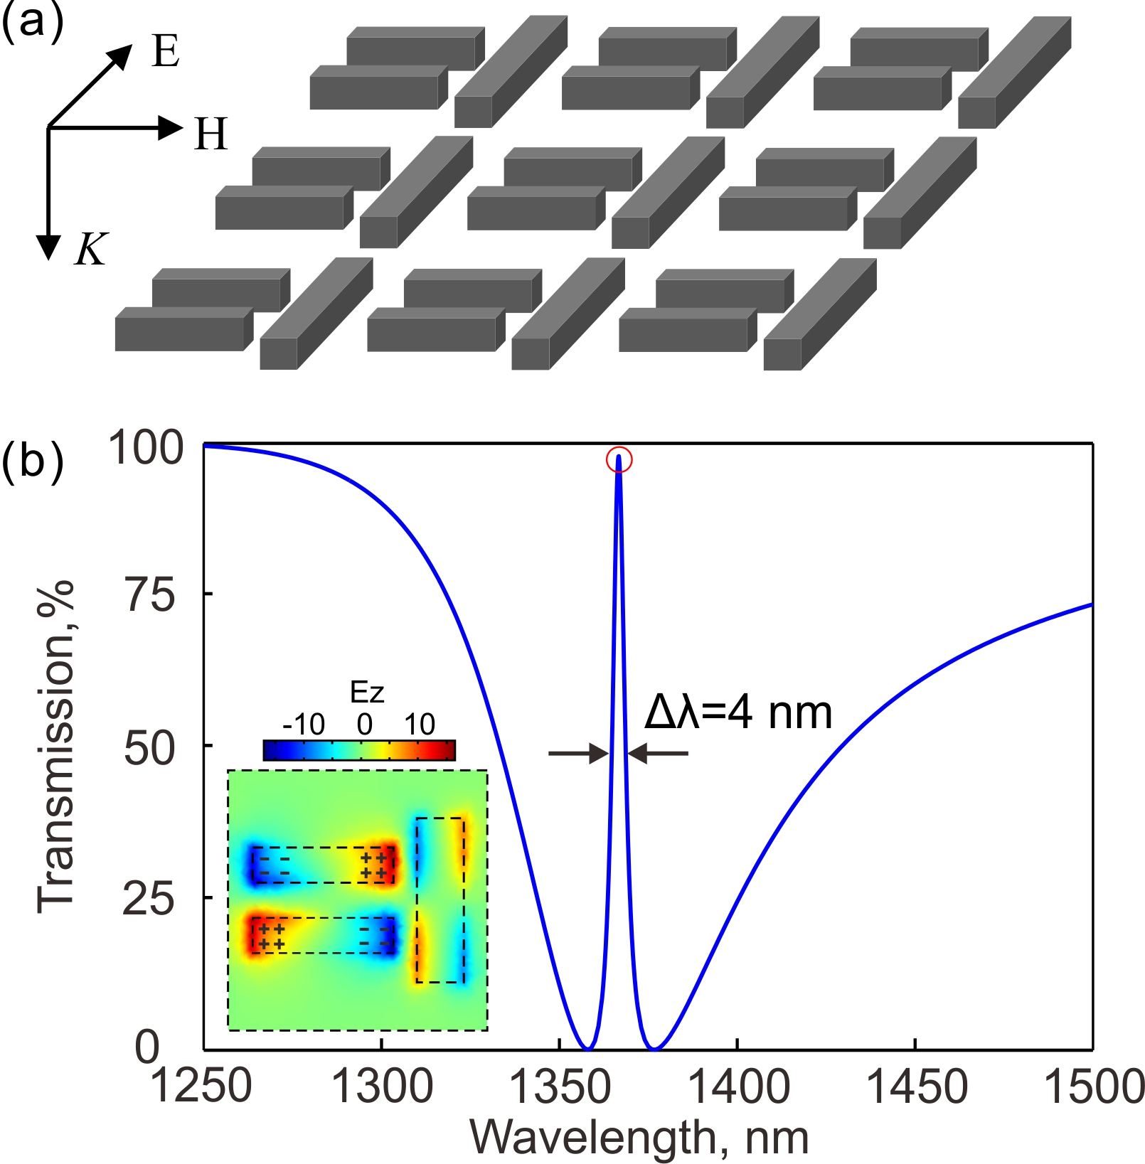
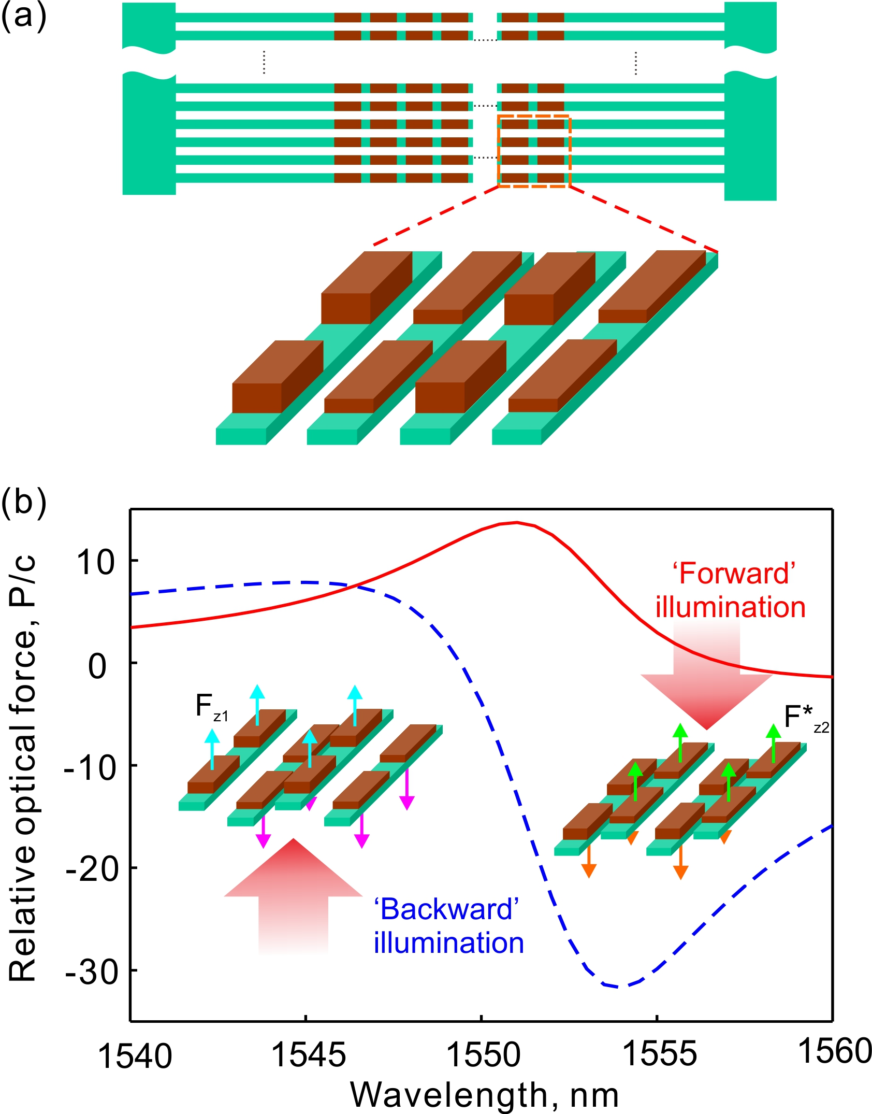
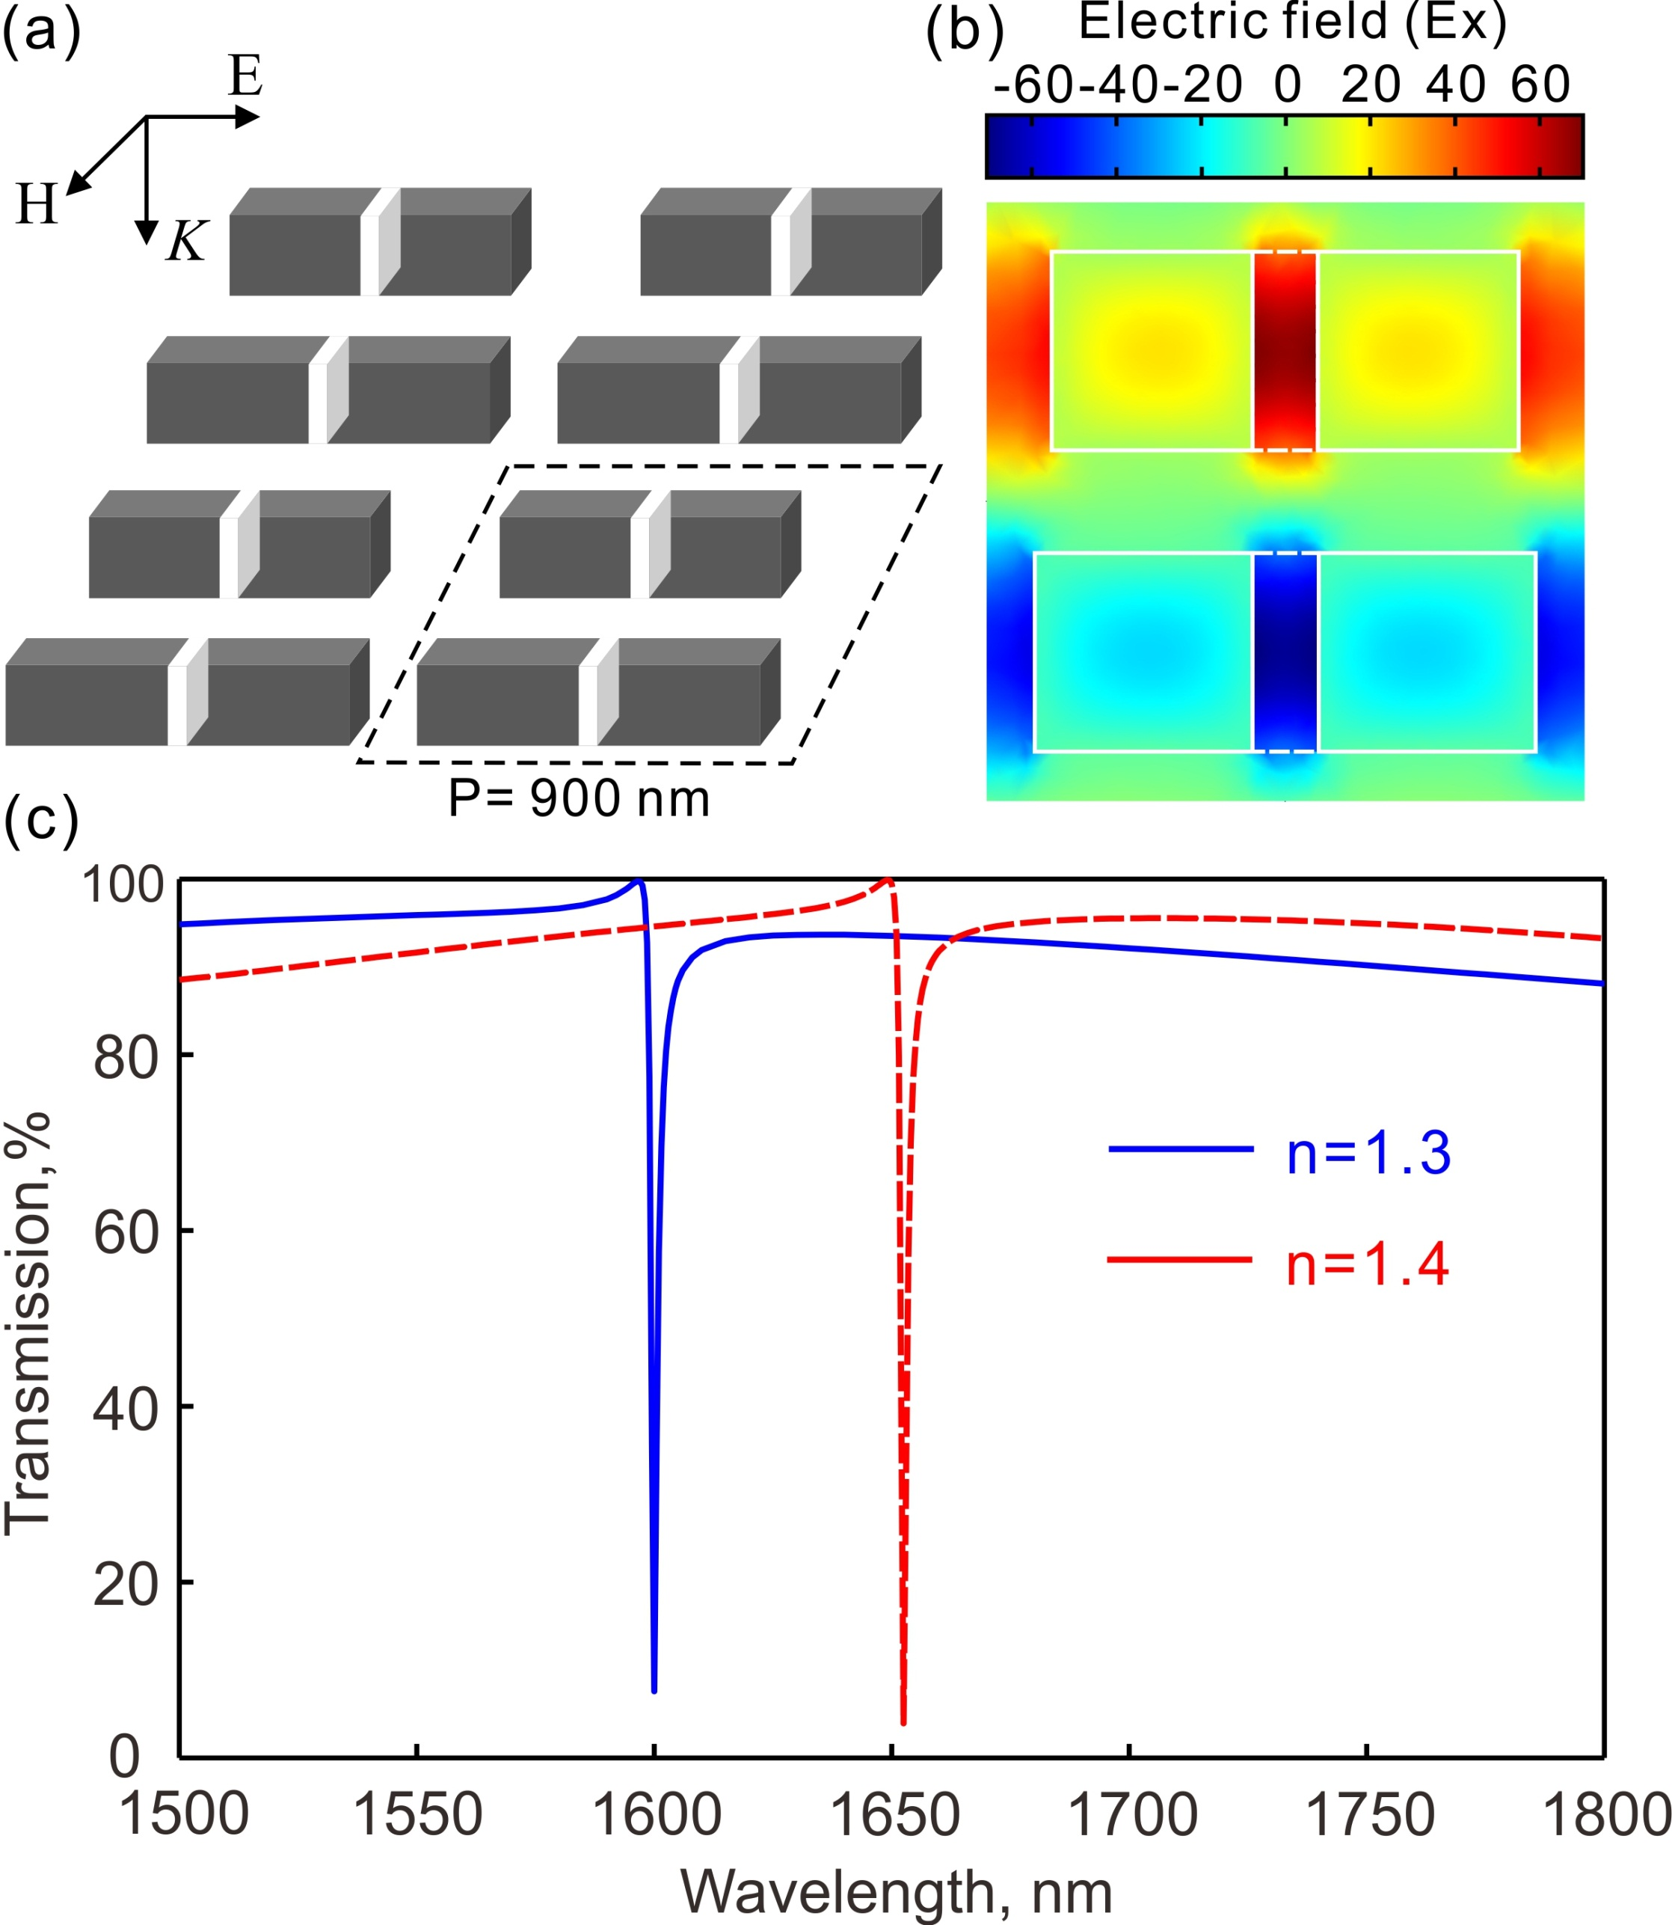
Poster Title
Author(s)*
（Affliation, Adress）
*Email adress
Replace with your logo
INTRODUCTION
METHODS
For a decade and more, considerable effort has been focused on the engineering of metamaterials to achieve high-quality resonant optical responses for applications ranging from negative refraction to detection, signal modulation, and biosensing. However, most of metamaterials comprise arrays of sub-wavelength metallic resonators. Thus they suffer from high inherent resistive losses in the metal and the quality factor of resonances is limited.
High-refractive-index dielectrics offer an alternative to metals. Dielectric particles display Mie resonances with very low absorption losses when illumination energy is below the bandgap. Furthermore, by exploiting the coupling between the dielectric resonators and the collective oscillations of unit cells, “trapped mode” or Fano resonances with low radiative losses can be excited in planar dielectric metamaterials. Such high quality resonances provide an platform for strong light-matter interactions with potential in a variety of applications.
Proposed dielectric metamaterials consist of periodical array of sub-wavelength dielectric particles.
Highly refractive dielectrics with low losses at focused frequencies, such as silicon and germanium, are employed;
Fano-resonances are realized through coupling between resonators with broken asymmetry;
Nanophotonics and nanomechanics are bridged via resonant optical forces.
Further improvement of field enhancement and light localization is realized using split optical resonators;
Numerical simulations:
Full-wave electromagnetic numerical simulations are performed using COMSOL MultiPhysics.
Optical forces are calculated using a surface integral:
Where S is a bounding surface around the object and Tij is the time averaged Maxwell stress tensor.
Fig. 1. (a) Trapped mode resonances in metallic (left) and dielectric (right) metamaterials based on the anti-phase oscillation of conduction or displacement currents. (b) Measured refractive index of silicon. The inset shows an electron microscope image of a fabricated silicon metamaterial.
RESULTS
Optical responses of planar dielectric metamaterials with different geometric designs are numerically studied. Fano resonances with quality factors exceeding several hundreds can be achieved by minimizing radiative losses. Tens of times enhancement of optical forces and two order enhancement of electric field are predicted. Dielectric metamaterials can serve as optical refractive index sensors with a sensitivity of 525 nm/RIU and a figure-of-merit of a few hundreds.
Sharp Fano resonances
Resonant optical forces and optomechanical metamaterials
Light localization and giant field enhancement
Fig. 2. Electromagnetically induced transparency-like responses in all- dielectric metamaterials. (a) Schematic of a silicon metamaterial. (b) Simulated transmission spectrum of the metamaterial under the illumination of a plane wave at normal incidence as shown in (a). A transmission window arises in the stop-band around 1370 nm due to the coupling between radiative and subradiant modes. The inset shows the electric field (Ez at 5 nm above the top surface of the metamaterial) distribution at the transmission peak.
Fig. 4. Giant enhancement of electric field
Fig. 3. (a) Schematic of a dielectric optomechanical metamaterial. A dielectric metamaterial is supported by flexible silicon nitride nanomechanical beams. The metamaterial consists of periodical array of asymmetric silicon nanobars and display a Fano resonance around 1550 nm. (b) Spectral dispersion of the relative optical force on the two nanobar elements of a single metamaterial unit cell for both forward and backward illuminations of light. Optical force is presented in units of P/c, where P is the incident power per unit cell and c is the speed of light in vacuum.
Fig. 4. (a) A dielectric metamaterial using asymmetric split resonators as building blocks for light localization and giant enhancement of electric field. A 100 nm gap is introduced at the middle of each silicon nanobar. (b) Electric field distributions within a unit cell at the resonance. The light is incident at normal direction and polarized along the nanobars. The field is plotted at the metamaterial plane bisecting the nanobars and normalized to the field amplitude of the incident light. (c) Transmission spectra for the metamaterial on a silica substrate and covered by liquids with different refractive indices. The metamaterial can be used as a sensor with a sensitivity of 525 nm/RIU and a figure-of-merit of 170.
References:
J. Zhang, K. F. MacDonald, and N. I. Zheludev, “Nonlinear dielectric
optomechanical metamaterials,” Light: Sci. App. (2013).
(2) J. Zhang, K. F. MacDonald, and N. I. Zheludev, “ Near-infrared trapped mode magnetic resonance in an all-dielectric metamaterial, ” Opt. Express (2013).
(3) J. Zhang, K. F. MacDonald, and N. I. Zheludev, “Giant Optical Forces in Planar Dielectric Photonic Metamaterials,” submitted.
(4) J. Zhang et al, “Electromagnetically induced transparency like optical responses in all-dielectric metamaterials,” submitted.
(5) J. Zhang et al, “Light localization and giant field enhancement in all dielectric metamaterials using split resonators as building blocks,” to be submitted.
CONCLUTION
FUNDING
Dielectric metamaterials and metasurfaces exhibit resonances with unprecedented quality factors and provide a novel platform for enhancing light-matter interactions. Currently, rapid progresses are being made in both theory and experimental demonstration of dielectric metamaterials. The development of high quality dielectric metamaterials will present opportunities for slow light, enhanced nonlinearity, sensing applications and make the realization of new types of active lasing and optomechanical metamaterials possible.
This work was supported by the National Natural Science Foundation of China (Grant no. xxxxxx).
Light Conference 2025
June 9-13, Changchun, China

Slide 2
Requirements for poster preparation
Language：English
Size: Width: 0.8 m x Height: 1.2 m

